Slide 1
Alzheimer’s Disease and Dementia
in New Mexico
Health Systems Epidemiology Program
September 11, 2015

Slide 2
• Alzheimer’s Disease is a progressive disease and is the most common form of dementia. Symptoms include memory loss, disorientation, mood and behavior changes, difficulty speaking, swallowing, and walking.
• Dementia is a general term for a decline in mental ability severe enough to interfere with daily life. Alzheimer’s disease accounts for 60-80% of all dementia cases with Vascular dementia being the second most common type of dementia.
Notes:
The greatest known risk factor is increasing age, the majority of people with Alzheimer’s disease are 65+. A small proportion of individuals (~5%) will suffer from early onset Alzheimer’s disease, often appearing when the individuals is in their 40s or 50s.
No cure for Alzheimer’s disease though it is possible to slow the worsening of dementia symptoms (through memory loss medication and treatment for behavioral changes).
Currently lots of research ongoing around Alzheimer’s disease and related dementias through the study of the disease on the human brain. A lot of what is currently known about this disease was discovered in the last 15 years.
Vascular dementia typically occurs after an individual suffers from a stroke.
Diagnosis of dementia is based on medical history, a physical examination, laboratory tests, and the characteristic changes in thinking, day-to-day function and behavior. Hard to determine the exact type of dementia (requires a visit to a specialist such as a neurologist or gero-psychologist).

Slide 3
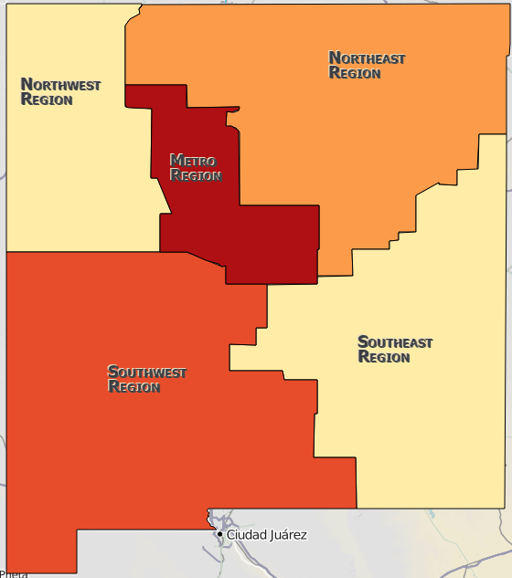
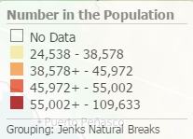
Older Adult Population in New Mexico
https://ibis.health.state.nm.us/query/result/pop/PopMain/Count.html

Slide 4
Medicare Data
Methods
• Centers for Medicare and Medicaid Services (CMS) Public Use File
- All Beneficiaries, State/County Tables (as of February 2015)
- Most current dataset: 2013
• Available to the Public
-https://www.cms.gov/Research-Statistics-Data-and-Systems/Statistics- Trends-and-Reports/Medicare-Geographic-Variation/GV_PUF.html

Slide 5
Medicare Data
Alzheimer’s and Related Disorders

Slide 6
Medicare Data
Alzheimer’s and Related Disorders
Notes:
New Mexico Specific data
Percent Increase in Number of Cases from 2009-2013 was 5.3%
Percent Increase in Number of Beneficiaries: 14.8%

Slide 7
Emergency Department Data

Slide 8
Emergency Department Data
Methods
• 5 Years of data – 2010 through 2014
• Alzheimer’s Cases were defined as:
- A diagnosis code of 331.0 (ICD 9 Coding)
• Dementia Cases were defined as:
- Diagnosis Codes: 290.0-290.9, 291.2, 292.82, 294.10, 294.11, 294.20, 294.21, 331.19, and 331.82 (ICD 9 Coding)
• Data submitted by non-federal facilities.
• Additional data elements for analysis
a) Age (mean and range)
b) Sex
c) Race/Ethnicity
d) County of Residence
Notes:
Additional Dementia codes beyond 290 are in line with CMS guidelines for defining dementia.

Slide 9
Emergency Department Data
Results

Slide 10
Emergency Department Data
Alzheimer’s Results

Slide 11
Emergency Department Data
Alzheimer’s Results

Slide 12
Emergency Department Data
Alzheimer’s Results

Slide 13
Emergency Department Data
Alzheimer’s Results

Slide 14
Emergency Department Data
Dementia Results

Slide 15
Emergency Department Data
Dementia Results

Slide 16
Emergency Department Data
Dementia Results

Slide 17
Emergency Department Data
Dementia Results

Slide 18
Hospitalization Data

Slide 19
Inpatient Hospitalization Data
Methods
• 4 Years of data – 2010 through 2013
• Alzheimer’s Cases were defined as:
- A diagnosis code of 331.0 (ICD 9 Coding)
• Dementia Cases were defined as:
- A diagnosis code of 290.0-290.9, 291.2, 292.82, 294.10, 294.11, 294.20, 294.21, 331.19, and 331.82 (ICD 9 Coding)
• Data submitted by federal and non-federal facilities.
• Additional data elements for analysis
a) Age (mean and range)
b) Sex
c) Race/Ethnicity
d) County of Residence

Slide 20
Inpatient Hospitalization Data
Alzheimer’s Results

Slide 21
Inpatient Hospitalization Data
Alzheimer’s Results

Slide 22
Inpatient Hospitalization Data
Alzheimer’s Results

Slide 23
Inpatient Hospitalization Data
Alzheimer’s Results

Slide 24
Inpatient Hospitalization Data
Dementia Results

Slide 25
Inpatient Hospitalization Data
Dementia Results

Slide 26
Inpatient Hospitalization Data
Dementia Results

Slide 27
Inpatient Hospitalization Data
Dementia Results

Slide 28
Vital Records Data
Methods
• 6 Years of data – 2009 through 2014
• Alzheimer’s Cases were defined as:
- An underlying cause of death code of G30.0-G30.9 (ICD 10 Coding)
• Dementia Cases were defined as:
- An underlying cause of death code of F01-F03 (ICD 10 Coding)
• Additional data elements for analysis
a) Age (mean and range)
b) Sex
c) Race/Ethnicity
d) County of Residence

Slide 29
Vital Records Data
Results
Notes:
Among deaths occurring in individuals 65 years and older, the combination of Alzheimer’s and Dementia accounts for between 10.5-11.5% of deaths in this age group (this is compared to the 6.5-7.5% of deaths for all age groups).
In 2010 -2013, Alzheimer’s was the 9th leading cause of death in New Mexico and the 6th leading cause of death in the United States (Health Statistics Annual Reports).
In 2009, Alzheimer’s was the 8th leading cause of death in New Mexico.

Slide 30
Vital Records Data
Alzheimer’s Results

Slide 31
Vital Records Data
Alzheimer’s Results

Slide 32
Vital Records Data
Alzheimer’s Results

Slide 33
Vital Records Data
Alzheimer’s Results
Notes:
Population Estimates from NM-IBIS restricted to individuals 65 years and older.

Slide 34
Vital Records Data
Dementia Results

Slide 35
Vital Records Data
Dementia Results

Slide 36
Vital Records Data
Dementia Results

Slide 37
Vital Records Data
Dementia Results
Notes:
Population Estimates from NM-IBIS restricted to individuals 65 years and older.

Slide 38
Conclusions
• From 2012-2014, the majority of Dementia deaths occurred in the Metro region, but the majority of Dementia ED admissions occurred in the NE, SE, and SW regions. Similar pattern for Alzheimer’s ED admissions and deaths.
• In general, more females suffer from Alzheimer’s Disease and Dementia Related Diseases compared to males.
• In general, females were older (at death and for ED admissions) compared to males.
• The majority of individuals with either Alzheimer’s Disease or Dementia were above the age of 65 years.
• The addition of ICD 9 code 294.20 and 294.21 in 2011/2012 for Unspecified Dementia, led to a large increase in the overall number of ED admissions for Dementia Related Disease.
Notes:
In a given year for ED admissions, only 5-10% of individual’s with Alzheimer’s Disease or Dementia Related Disease were under the age of 65 years.
In a given year for deaths, only ~2% of individual’s with Alzheimer’s Disease or Dementia Related Disease were under the age of 65 years.

Slide 39
Questions
Victoria Dirmyer
Health Systems Epidemiologist
Health Systems Epidemiology Program
Epidemiology and Response Division
New Mexico Department of Health
505-476-3572
Victoria.Dirmyer@state.nm.us
Abubakar Ropri
Health Systems Epidemiologist
Health Systems Epidemiology Program
Epidemiology and Response Division
New Mexico Department of Health
505-476-3584
Abubakar.Ropri@state.nm.us

