Slide 1
Health Status of Older Adults in New Mexico
Michael Landen
New Mexico Department of Health
September 2015

Slide 2
Purpose
Review highlights of the health status of older adults in New Mexico
Demographics
Risk Behaviors
Morbidity
Death
Trends
Disparities

Slide 3
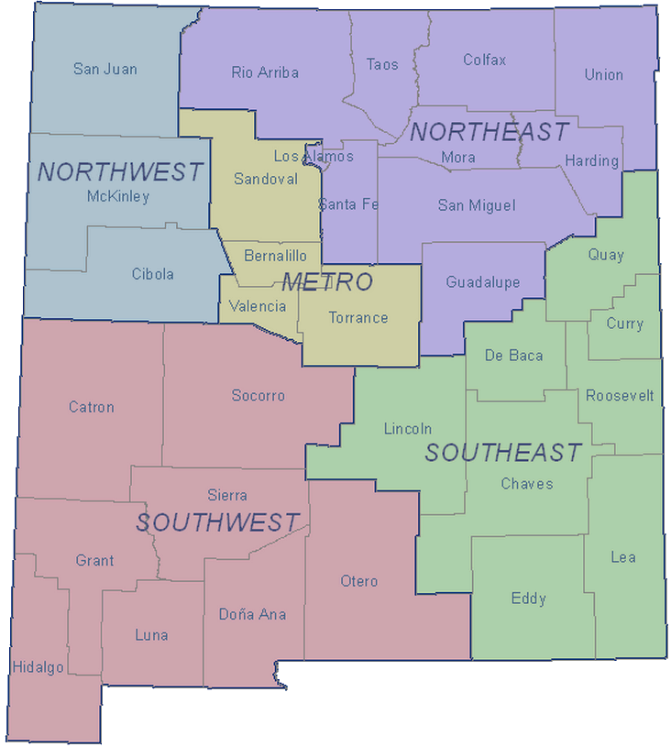
New Mexico Health Regions

Slide 4
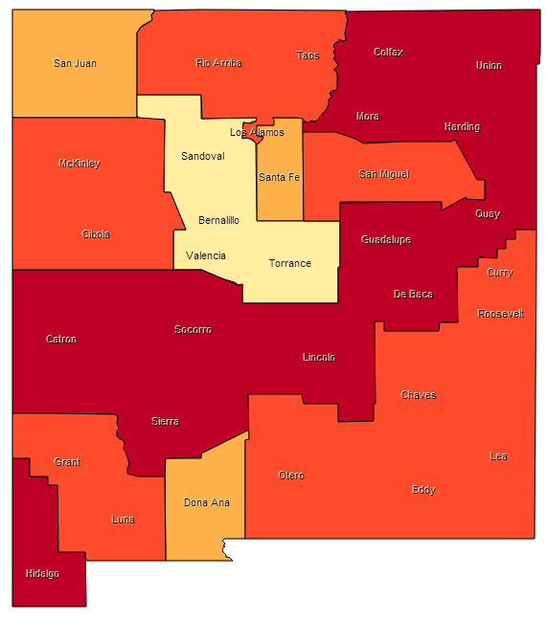
NM Urban-Rural County Classification
Metropolitan Counties
Small Metro Counties
Mixed Urban/Rural Counties
Rural Counties

Slide 5
Percentage of NM Adults Age 65+ Living in Households with Annual Income of Less Than $20,000 by Region, 2014
Comparison of Crude Occupational Injury Fatality Rates: NM and US, 1998-2002
Source: Behavioral Risk Factor Surveillance System
Notes:
Annual Household Income is associated with General Health Status. Adults living in households with lower annual income were more likely to report Fair or Poor Health Status.

Slide 6
Percentage of NM Adults Living in Households with Annual Income of Less Than $20,000 by Age Group, 2014
Source: Behavioral Risk Factor Surveillance System
Notes:
Annual Household Income is associated with General Health Status. Adults living in households with lower annual income were more likely to report Fair or Poor Health Status.

Slide 7
Percentage of NM Adults Age 65+
With Less Than High School Education by Region, 2014
Comparison of Crude Occupational Injury Fatality Rates: NM and US, 1998-2002
Source: Behavioral Risk Factor Surveillance System
Notes:
Education Level is associated with General Health Status. Adults with less than a High School education were more likely to report Fair or Poor Health Status. In 2009, thirty-nine percent (39.2%) of adults with less than a high school education reported Fair or Poor health status, while only eight percent (8.4%) adults with at least one college degree reported Fair or Poor health status.

Slide 8
Percentage of NM Adults With Less Than High School Education by Age Group, 2014
Source: Behavioral Risk Factor Surveillance System
Notes:
Annual Household Income is associated with General Health Status. Adults living in households with lower annual income were more likely to report Fair or Poor Health Status.

Slide 9
Percentage of NM Adults Age 65+ Without Health Care Coverage by Region, 2014
Comparison of Crude Occupational Injury Fatality Rates: NM and US, 1998-2002
Statewide:
98.0% of adults age 65+ have coverage.
92.9% of Adults age 65+ are covered by Medicare
Source: Behavioral Risk Factor Surveillance System
Notes:
Annual Household Income is associated with General Health Status. Adults living in households with lower annual income were more likely to report Fair or Poor Health Status.

Slide 10
Percentage of NM Adults Without Health Care Coverage by Age Group, 2014
Statewide:
98.0% of adults age 65+ have coverage.
92.9% of Adults age 65+ are covered by Medicare
Source: Behavioral Risk Factor Surveillance System
Notes:
Annual Household Income is associated with General Health Status. Adults living in households with lower annual income were more likely to report Fair or Poor Health Status.

Slide 11
General Health Status Reported As Fair or Poor Among New Mexico Adults by Age Group, 2014
Source: Behavioral Risk Factor Surveillance System
Notes:
Annual Household Income is associated with General Health Status. Adults living in households with lower annual income were more likely to report Fair or Poor Health Status.

Slide 12
General Health Status Reported As Fair or Poor Among New Mexico Adults Age 65+ by Annual Household Income, 2014
Source: Behavioral Risk Factor Surveillance System
Notes:
Annual Household Income is associated with General Health Status. Adults living in households with lower annual income were more likely to report Fair or Poor Health Status.

Slide 13
General Health Status Reported As Fair or Poor Among New Mexico Adults Age 65+ by Education, 2014
SOURCE: Behavioral Risk Factor Surveillance System
Notes:
Education Level was associated with General Health Status. As Education Level increased, self-report of Fair or Poor Health Status decreased.

Slide 14
General Health Status Reported As Fair or Poor Among New Mexico Adults Age 65+ by Race/Ethnicity, 2014
SOURCE: Behavioral Risk Factor Surveillance System
Notes:
Hispanic Adults were more likely to report Fair or Poor Health Status than members of other Race/Ethnic Groups. Age adjustment did not affect this relationship. Insufficient sample size made comparisons between some groups difficult.

Slide 15
General Health Status Reported As Fair or Poor Among New Mexico Adults Age 65+ by Region, 2014
SOURCE: Behavioral Risk Factor Surveillance System
Notes:
Education Level was associated with General Health Status. As Education Level increased, self-report of Fair or Poor Health Status decreased.

Slide 16
General Health Status Reported As Fair or Poor Among New Mexico Adults Age 65+ by Urban/Rural, 2014
SOURCE: Behavioral Risk Factor Surveillance System
Notes:
Education Level was associated with General Health Status. As Education Level increased, self-report of Fair or Poor Health Status decreased.

Slide 17
Current Smoking Among New Mexico Adults by Age Group, 2014
Source: Behavioral Risk Factor Surveillance System
Notes:
Annual Household Income is associated with General Health Status. Adults living in households with lower annual income were more likely to report Fair or Poor Health Status.

Slide 18
Current Smoking Among New Mexico Adults Age 65+ by Annual Household Income, 2014
SOURCE: Behavioral Risk Factor Surveillance System
Notes:
Annual Household Income is associated with Tobacco Use. Adults living in households with lower annual income were more likely to report that they currently smoked cigarettes.

Slide 19
Current Smoking Among New Mexico Adults Age 65+ by Education, 2014
SOURCE: Behavioral Risk Factor Surveillance System
Notes:
Education Level was associated with Tobacco Use. Reports of tobacco use declined with increased education.

Slide 20
Current Smoking Among New Mexico Adults Age 65+ by Race/Ethnicity, 2014
SOURCE: Behavioral Risk Factor Surveillance System
Notes:
Race/Ethnicity was not associated with Tobacco Use.

Slide 21
Current Smoking Among New Mexico Adults Age 65+ by Region, 2014
SOURCE: Behavioral Risk Factor Surveillance System
Notes:
Education Level was associated with Tobacco Use. Reports of tobacco use declined with increased education.

Slide 22
Current Smoking Among New Mexico Adults Age 65+ by Urban/Rural, 2014
SOURCE: Behavioral Risk Factor Surveillance System
Notes:
Education Level was associated with Tobacco Use. Reports of tobacco use declined with increased education.

Slide 23
Obesity – BMI ≥ 30 Among New Mexico Adults by Age Group, 2014
Source: Behavioral Risk Factor Surveillance System
Notes:
Annual Household Income is associated with General Health Status. Adults living in households with lower annual income were more likely to report Fair or Poor Health Status.

Slide 24
Diagnosed Diabetes Among New Mexico Adults by Age Group, 2014
Source: Behavioral Risk Factor Surveillance System
Notes:
Annual Household Income is associated with General Health Status. Adults living in households with lower annual income were more likely to report Fair or Poor Health Status.

Slide 25
Percentage of NM Adults Who Always Wear Seatbelt by Age Group, 2014
Heavy Drinking:
Among Males, 3+ Drinks Per Day.
Among Females, 2+ Drinks Per Day.
Source: Behavioral Risk Factor Surveillance System
Notes:
Annual Household Income is associated with General Health Status. Adults living in households with lower annual income were more likely to report Fair or Poor Health Status.

Slide 26
Percentage of NM Adults Who Do Not Engage in
Any Leisure-time Physical Activity by Age Group, 2014
Source: Behavioral Risk Factor Surveillance System
Notes:
Annual Household Income is associated with General Health Status. Adults living in households with lower annual income were more likely to report Fair or Poor Health Status.

Slide 27
Percentage of NM Adults Who Engaged in Binge Drinking
at Least Once in the Past 30 Days by Age Group, 2014
Source: Behavioral Risk Factor Surveillance System
Notes:
Annual Household Income is associated with General Health Status. Adults living in households with lower annual income were more likely to report Fair or Poor Health Status.

Slide 28
Percentage of NM Adults Who Were Heavy Drinkers by Age Group, 2014
Heavy Drinking:
Among Males, 3+ Drinks Per Day.
Among Females, 2+ Drinks Per Day.
Source: Behavioral Risk Factor Surveillance System
Notes:
Annual Household Income is associated with General Health Status. Adults living in households with lower annual income were more likely to report Fair or Poor Health Status.

Slide 29
Invasive Pneumococcal Disease Rates by Age Group New Mexico, 2012-2014

Slide 30
Invasive Pneumococcal Disease Rates 65+ by Gender New Mexico, 2012-2014

Slide 31
Invasive Pneumococcal Disease Rates 65+ by Region New Mexico, 2012-2014

Slide 32
Invasive Pneumococcal Disease Rates 65+ By Rural/Urban Designation New Mexico, 2012-2014

Slide 33
Invasive Pneumococcal Disease Rates 65+ by Race/Ethnicity New Mexico, 2012-2014

Slide 34
Influenza Hospitalization Rates by Age Group New Mexico, 2014
Source: NM EIP

Slide 35
Influenza Hospitalization Rates 65+ by Race/Ethnicity New Mexico, 2014
Source: NM EIP

Slide 36
Influenza Hospitalization Rates 65+ by Gender, New Mexico, 2014
Source: NM EIP

Slide 37
Health Status of New Mexico Life Expectancy from Age 65

Slide 38
Life Expectancy from Age 65 New Mexico and United States, 1999 - 2013
Source: NM IBIS; CDC NVSR
Notes:
Self-reported General Health Status as Fair or Poor among adults (age 18 and over), New Mexico and US.
The prevalence of self-reported general health as fair or poor among adults has remained relatively stable over the past decade. The percentage of New Mexico adults reporting fair or poor health has been 2 to 3 percentage points higher than the nation as a whole over the past decade.

Slide 39
Life Expectancy from Age 65 by Sex New Mexico and United States, 1999 - 2013
Source: NM IBIS; CDC NVSR
Notes:
Self-reported General Health Status as Fair or Poor among adults (age 18 and over), New Mexico and US.
The prevalence of self-reported general health as fair or poor among adults has remained relatively stable over the past decade. The percentage of New Mexico adults reporting fair or poor health has been 2 to 3 percentage points higher than the nation as a whole over the past decade.

Slide 40
Life Expectancy from Age 65 by Race/Ethnicity New Mexico, 1999 - 2013
Source: NM IBIS
Notes:
Self-reported General Health Status as Fair or Poor among adults (age 18 and over), New Mexico and US.
The prevalence of self-reported general health as fair or poor among adults has remained relatively stable over the past decade. The percentage of New Mexico adults reporting fair or poor health has been 2 to 3 percentage points higher than the nation as a whole over the past decade.

Slide 41
Life Expectancy from Age 65 by Sex New Mexico and United States, 2013
Source: NM IBIS; CDC NVSR

Slide 42
Life Expectancy from Age 65 by Race/Ethnicity New Mexico, 2013
Source: NM IBIS

Slide 43
Life Expectancy from Age 65 by Health Region New Mexico, 2013
Source: NM IBIS

Slide 44
Life Expectancy from Age 65 by Rural/Urban Categories New Mexico, 2013
Source: NM IBUIS

Slide 45
Total Death Rates Ages 65+ by Region New Mexico, 2014
Source: NM Bureau of Vital Records and Health Statistics

Slide 46
Total Death Rates by Ages 65+ by Race/Ethnicity and Sex New Mexico, 2014
Rates per 100,000 population
Source: NM Bureau of Vital Records and Health Statistics
Notes:
API = Asian Pacific Islander
Amer Indian= American Indian or Alaska Native

Slide 47
Top 8 Leading Causes of Death For Ages 65 - 74, New Mexico, 2014 and U.S., 2013
New Mexico | Rank
Cancer | 1
Heart Disease | 2
Chronic lower respiratory diseases | 3
Diabetes mellitus | 4
Cerebrovascular diseases | 5
Accidents (unintentional injuries) | 6
Chronic liver disease and cirrhosis | 7
Influenza and pneumonia | 8
United States
Cancer
Heart Disease
Chronic lower respiratory diseases
Cerebrovascular diseases
Diabetes mellitus
Accidents (unintentional injuries)
Nephritis, nephrotic syndrome & nephrosis
Septicemia
Source, New Mexico: Vital Records and Health Statistics
United States: National Center for Health Statistics

Slide 48
Top 8 Leading Causes of Death For Ages 75 - 84, New Mexico, 2014 and U.S., 2013
New Mexico | Rank
Cancer | 1
Heart Disease | 2
Chronic lower respiratory diseases | 3
Cerebrovascular diseases | 4
Diabetes mellitus | 5
Alzheimer's disease | 6
Accidents (unintentional injuries) | 7
Parkinson's disease | 8
United States
Cancer
Heart Disease
Chronic lower respiratory diseases
Cerebrovascular diseases
Alzheimer's disease
Diabetes mellitus
Accidents (unintentional injuries)
Influenza and pneumonia
Source, New Mexico: Vital Records and Health Statistics
United States: National Center for Health Statistics

Slide 49
Top 8 Leading Causes of Death For Ages 85+, New Mexico, 2014 and U.S., 2013
New Mexico | Rank
Heart Disease | 1
Cancer | 2
Cerebrovascular diseases | 3
Chronic lower respiratory diseases | 4
Alzheimer's disease | 5
Accidents (unintentional injuries) | 6
Diabetes mellitus | 7
Influenza and pneumonia | 8
United States
Heart Disease
Cancer
Alzheimer's disease
Cerebrovascular diseases
Chronic lower respiratory diseases
Influenza and pneumonia
Accidents (unintentional injuries)
Nephritis, nephrotic syndrome & nephrosis
Source, New Mexico: Vital Records and Health Statistics
United States: National Center for Health Statistics

Slide 50
5 Leading Causes of Death For Ages 65+ New Mexico, 2014, and U.S., 2013
Rates are per 100,000 population. Ranking is by New Mexico leading causes.
Source: National Center for Health Statistics; NM Vital Records and Health Statistics

Slide 51
Death Rates by Age Group New Mexico, 2014, and U.S., 2013
Source: National Center for Health Statistics; NM Vital Records and Health Statistics

Slide 52
Fall Death Rates Ages 65+ by Race/Ethnicity New Mexico, 2012-2014
Source: NM Bureau of Vital Records and Health Statistics

Slide 53
Fall Death Rates Ages 65+ by Sex New Mexico, 2012-2014
Source: NM Bureau of Vital Records and Health Statistics

Slide 54
Fall Death Rates Ages 65+ by Health Regions New Mexico, 2012-2014
Source: NM Bureau of Vital Records and Health Statistics

Slide 55
Fall Death Rates Ages 65+ by Rural Urban Counties New Mexico, 2012-2014
Source: NM Bureau of Vital Records and Health Statistics

Slide 56
MVI Death Rates Ages 65+ by Race/Ethnicity New Mexico, 2012-2014
Rate per 100,00 population
Source: NM Bureau of Vital Records and Health Statistics

Slide 57
MVI Death Rates Ages 65+ by Sex New Mexico, 2012-2014
Source: NM Bureau of Vital Records and Health Statistics

Slide 58
MVI Death Rates Ages 65+ by Health Regions New Mexico, 2012-2014
Source: NM Bureau of Vital Records and Health Statistics

Slide 59
MVI Death Rates Ages 65+ by Rural Urban Counties New Mexico, 2012-2014
Source: NM Bureau of Vital Records and Health Statistics

Slide 60
Suicide Death Rates Ages 65+ by Race/Ethnicity New Mexico, 2012-2014
Rate per 100,00 population
Source: NM Bureau of Vital Records and Health Statistics

Slide 61
Suicide Death Rates Ages 65+ by Sex New Mexico, 2012-2014
Source: NM Bureau of Vital Records and Health Statistics

Slide 62
Suicide Death Rates Ages 65+ by Health Regions New Mexico, 2012-2014
Source: NM Bureau of Vital Records and Health Statistics

Slide 63
Suicide Death Rates Ages 65+ by Rural Urban Counties New Mexico, 2012-2014
Source: NM Bureau of Vital Records and Health Statistics

Slide 64
P & I Death Rates Ages 65+ by Race/Ethnicity New Mexico, 2012-2014
Rate per 100,00 population
Source: NM Bureau of Vital Records and Health Statistics

Slide 65
P & I Death Rates Ages 65+ by Sex New Mexico, 2012-2014
Source: NM Bureau of Vital Records and Health Statistics

Slide 66
P & I Death Rates Ages 65+ by Health Regions New Mexico, 2012-2014
Source: NM Bureau of Vital Records and Health Statistics

Slide 67
P & I Death Rates Ages 65+ by Rural Urban Counties New Mexico, 2012-2014
Source: NM Bureau of Vital Records and Health Statistics

Slide 68
Heart Disease Death Rates Ages 65+ by Race/Ethnicity New Mexico, 2012-2014
Rate per 100,00 population
Source: NM Bureau of Vital Records and Health Statistics

Slide 69
Heart Disease Death Rates Ages 65+ by Sex New Mexico, 2012-2014
Source: NM Bureau of Vital Records and Health Statistics

Slide 70
Heart Disease Death Rates Ages 65+ by Health Regions New Mexico, 2012-2014
Source: NM Bureau of Vital Records and Health Statistics

Slide 71
Heart Disease Death Rates Ages 65+ by Rural Urban Counties New Mexico, 2012-2014
Source: NM Bureau of Vital Records and Health Statistics

Slide 72
Cancer Death Rates Ages 65+ by Race/Ethnicity New Mexico, 2012-2014
Rate per 100,00 population
Source: NM Bureau of Vital Records and Health Statistics

Slide 73
Cancer Death Rates Ages 65+ by Sex New Mexico, 2012-2014
Source: NM Bureau of Vital Records and Health Statistics

Slide 74
Cancer Death Rates Ages 65+ by Health Regions New Mexico, 2012-2014
Source: NM Bureau of Vital Records and Health Statistics

Slide 75
Cancer Death Rates Ages 65+ by Rural Urban Counties New Mexico, 2012-2014
Source: NM Bureau of Vital Records and Health Statistics

Slide 76
Sepsis Death Rates Ages 65+ by Race/Ethnicity New Mexico, 2012-2014
Rate per 100,00 population
Source: NM Bureau of Vital Records and Health Statistics

Slide 77
Sepsis Death Rates Ages 65+ by Sex New Mexico, 2012-2014
Source: NM Bureau of Vital Records and Health Statistics

Slide 78
Sepsis Death Rates Ages 65+ by Health Regions New Mexico, 2012-2014
Source: NM Bureau of Vital Records and Health Statistics

Slide 79
Sepsis Death Rates Ages 65+ by Rural Urban Counties New Mexico, 2012-2014
Source: NM Bureau of Vital Records and Health Statistics

Slide 80
Conclusions
Life expectancy for New Mexico older adults is better than that for US older adults
Geographic, particularly unfavorable to rural areas, and racial/ethnic disparities persist in New Mexico
However the disparities do not appear to be as great as those for all ages health indicators
The health status of older adults in New Mexico should be tracked on a regular basis

