Slide 1
Growing Old Isn’t for the Faint of Heart…

Slide 2
About the Presenter
Stephanie L. Singleton OTD, OTR/L
Works at the new Rio Rancho Out-Patient Clinic located at HWY 528 and Rockaway Blvd.

Slide 3
Using Adaptations to Make Life Easier is OK!
Just because you are growing older doesn’t mean that you have to give up on the things that you enjoy!

Slide 4
Diseases that Can Impact Participation
Arthritis
Cerebrovascular disease (strokes)
Neurological diseases (Parkinson’s, MS, etc.)
Diabetes
COPD

Slide 5
Other Issues Related to Aging that Can Impact Participation
Decreased hearing and/or vision
Diminishing muscle strength
Decreased mobility
Increased risk for falls due to balance deficits
Increased risk for illness

Slide 6
Examples of Adaptive Equipment That Can Help Make Participation Easier

Slide 7
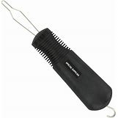
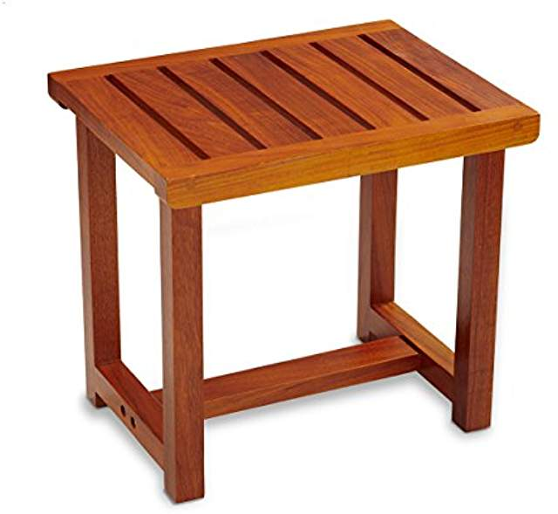
Adaptive Equipment for Use in ADL’s

Slide 8
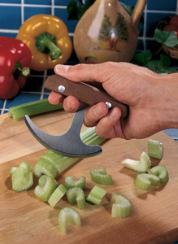
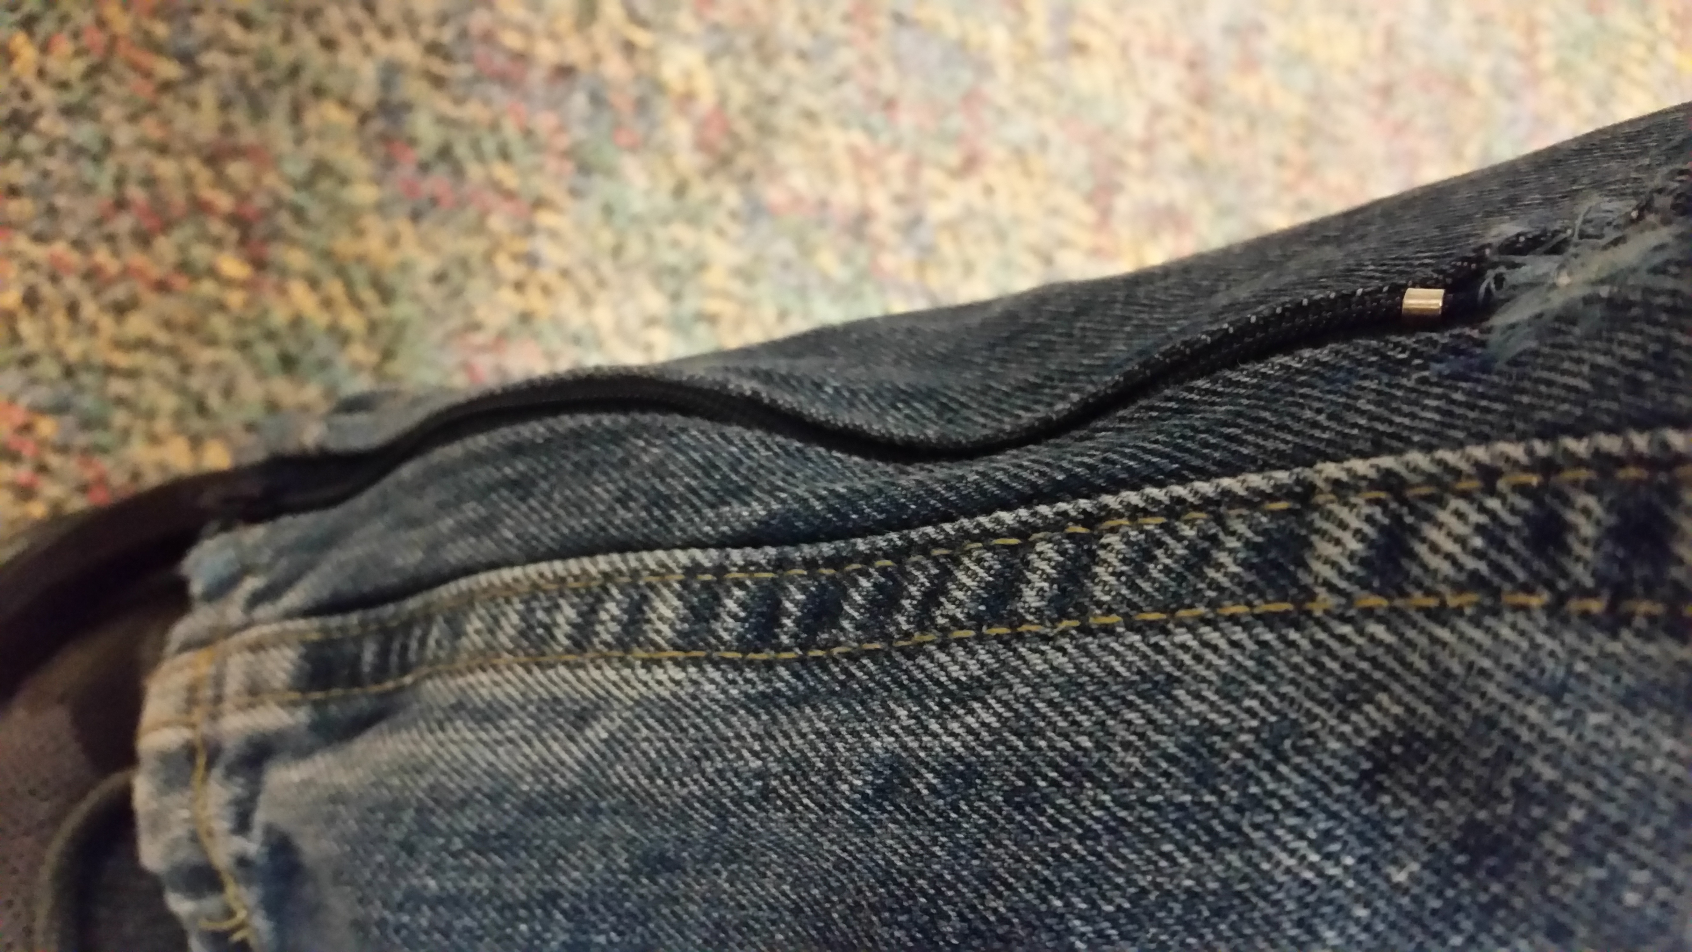
Other Adaptive Equipment for use in ADL’s

Slide 9
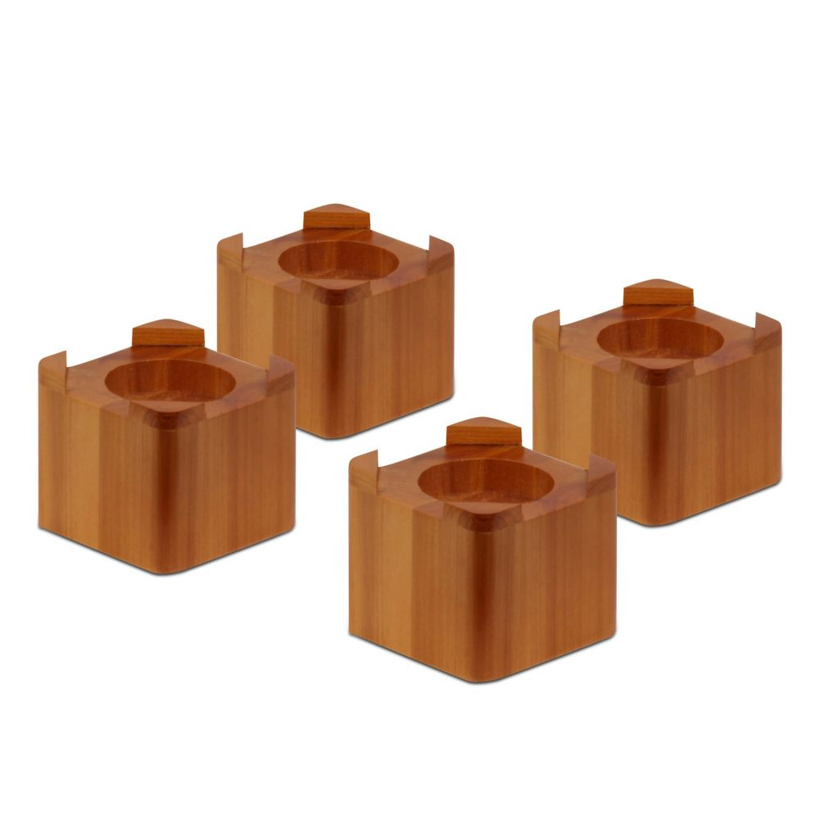
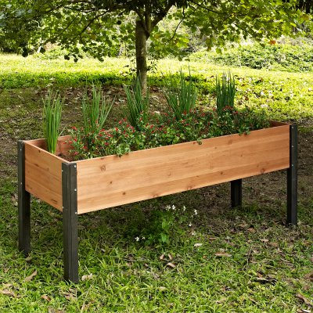
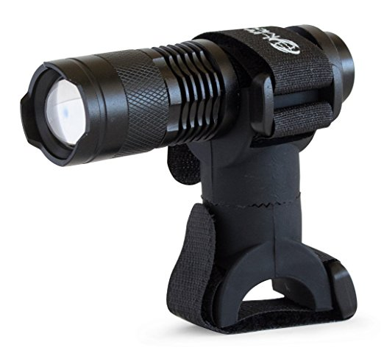
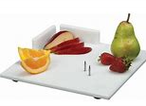
Equipment for use in IADL’s

Slide 10
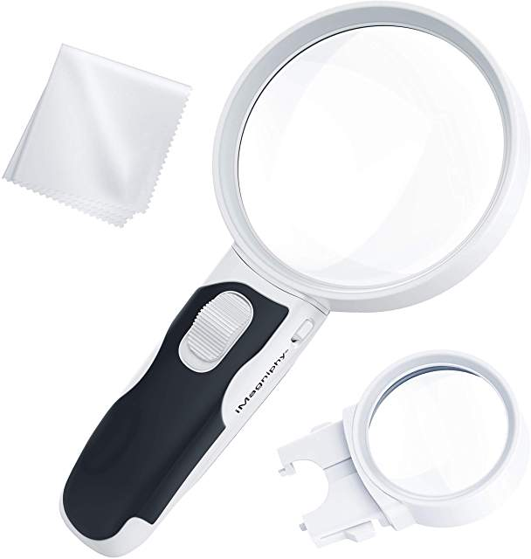
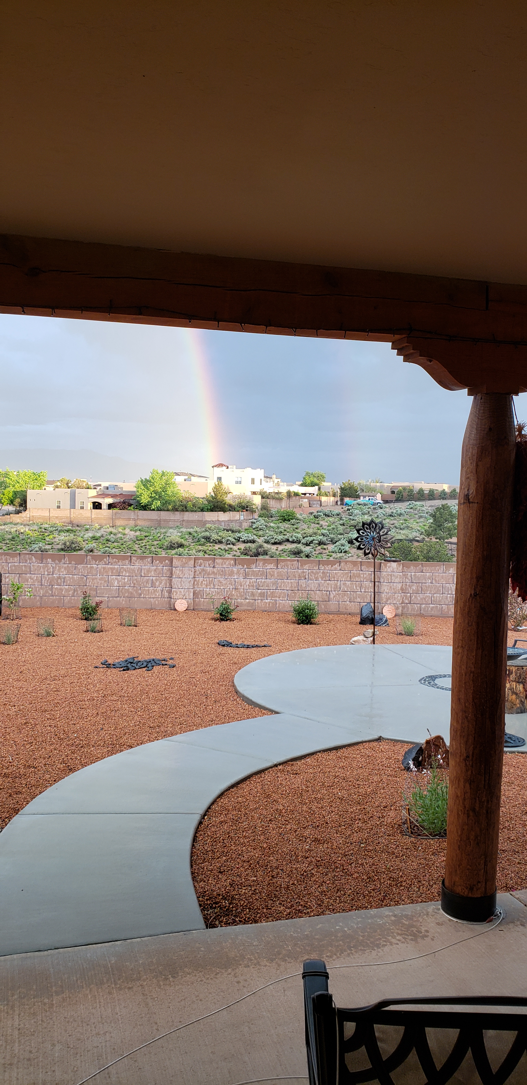
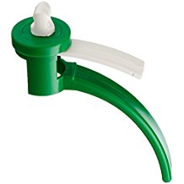
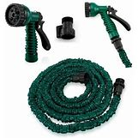
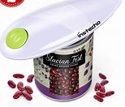
Other Adaptive Equipment for IADL’s

Slide 11
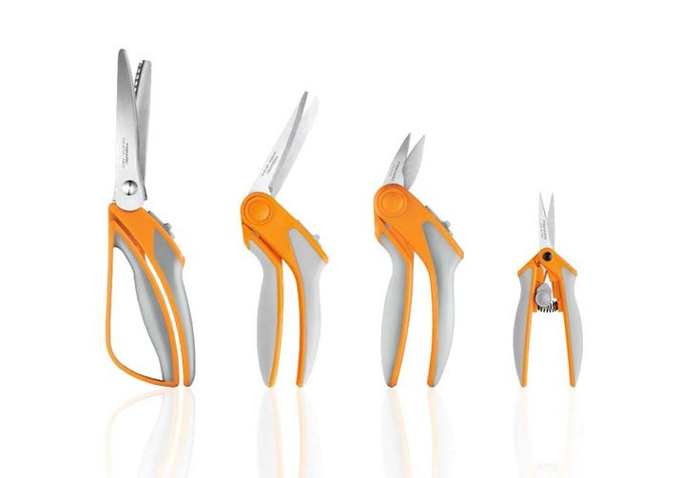
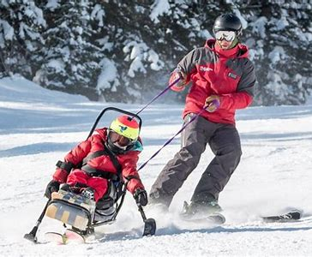
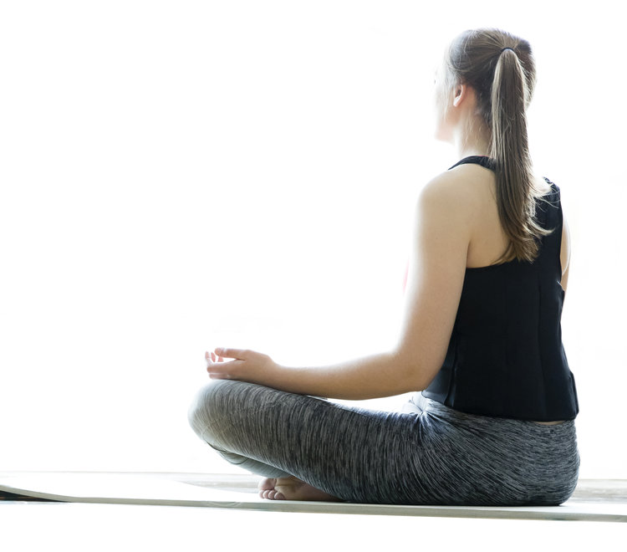
Adaptive Equipment for Use in Leisure Activities

Slide 12
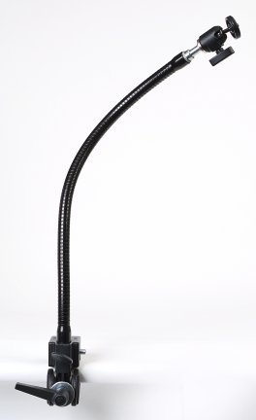
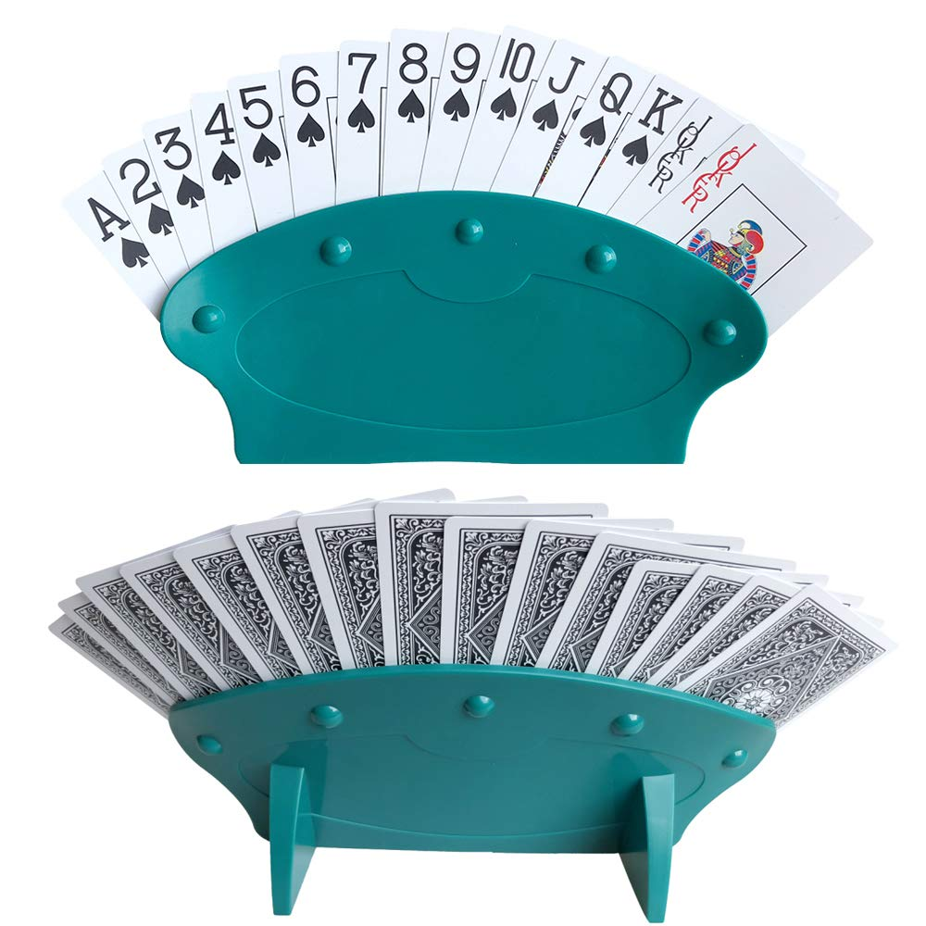
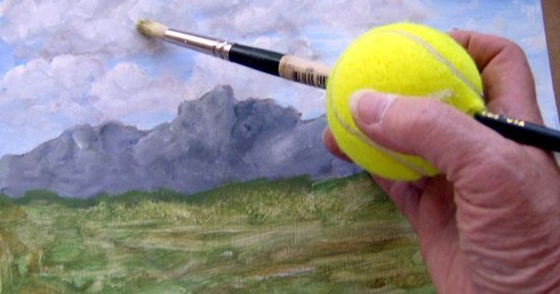
Other Adaptive Equipment for Use in Leisure Activities

Slide 13
Home Safety and Aging in Place
Most people want to be able to stay in their homes for as long as possible.
Here are some things to think about that can make your home safer.

Slide 14
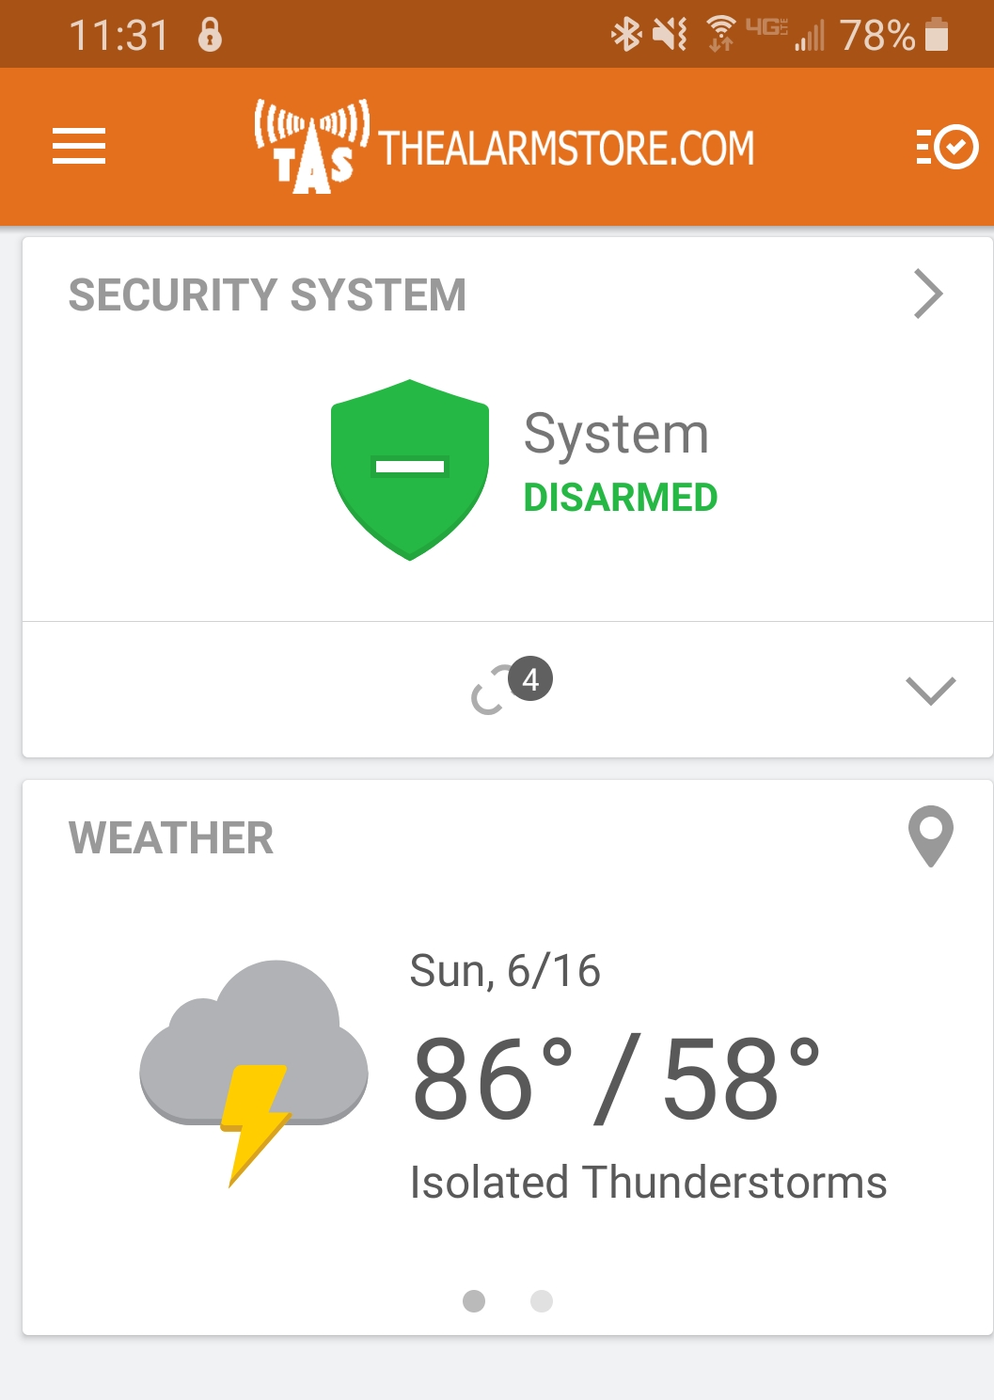
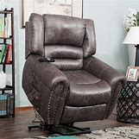
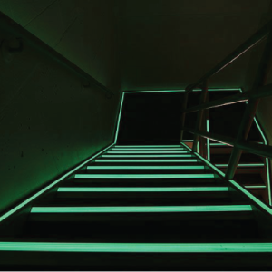
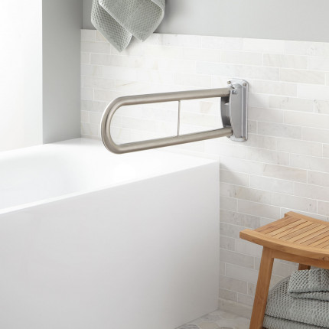
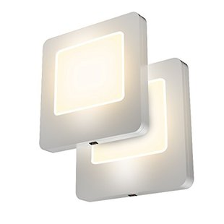
Home Safety

Slide 15
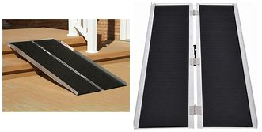
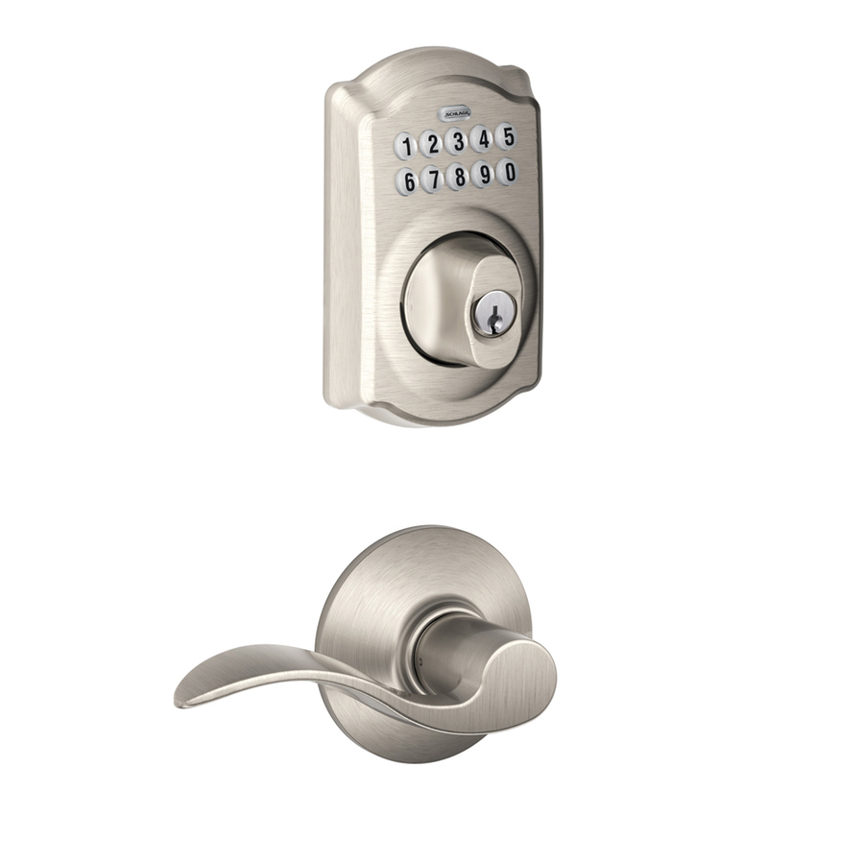
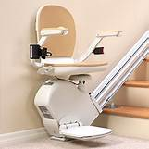
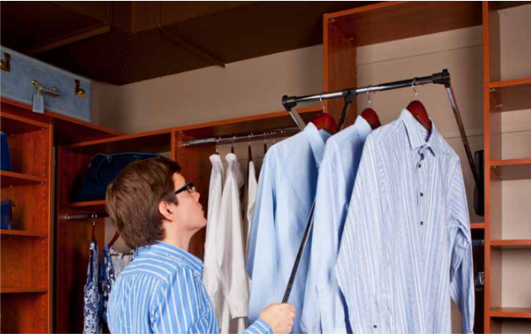
Home Modifications

Slide 16
Community Resources
Occupational Therapist
DME vendor
Thrift stores
Churches
Adaptive equipment banks (diagnosis specific)
Online shopping
Online information from reliable sources

Slide 17
Fall Prevention
Presented by: Lindsey Borders, PT, DPT

Slide 18
Approximately 30% of people aged 65 or older fall every year
Of those, 24% result in severe soft tissue injury AND fractures
15% of Emergency Room visits are associated with falls
Mortality rate associated with falls is 6%
40% of admissions to nursing homes are due to a fall

Slide 19
A Vicious Cycle
Increased caution and fear of falling
Loss of confidence for independent function
Reduced motivation to participate in activity
Decreased Strength and Balance
Increased Falls

Slide 20
Fall Etiology – Intrinsic Factors
Age
Sensory changes
Musculoskeletal changes
Neuromotor changes
Cardiovascular changes
Pharmaceutical challenges

Slide 21
Fall Etiology – Intrinsic Factors
Age: fall incidence increases with age
Sensory changes
Decreased vision, hearing loss, proprioceptive loss
Altered sensory organization and integration for balance
Dementia/Alzheimer’s Disease

Slide 22
Fall Etiology – Intrinsic Factors
Musculoskeletal changes
Muscle weakness
Decreased active range of motion in joints
Denial of physical limitations
Neuromotor changes
Vertigo/dizziness (multifactorial)
Slowed reaction time, impaired motor control

Slide 23
Fall Etiology – Intrinsic Factors
Cardiovascular changes
Decreased cardiovascular endurance (activity dependent)
Orthostatic hypotension
Heart arrhythmias

Slide 24
Fall Etiology – Intrinsic Factors
Pharmaceutical challenges
Strong evidence linking fall risk to psychotropic meds
Evidence linking drugs that cause peripheral vasodialation to falls (increasing risk of orthostatic hypotension)
Conflicting evidence linking hypoglycemic agents
Older adults with Type 2 diabetes are more likely to fall than matched peers
Diabetes medication related to an increased risk of fall for the elderly. Berlie HD, Garwood CL. 2010
Diabetes-related complications, glycemic control, and falls in older adults. Schwartz AV, Harris TB. 2008

Slide 25
Fall Etiology – Extrinsic Factors
Setting/Environment
Activity-related risk factors
Clothing

Slide 26
Fall Etiology – Extrinsic Factors
Setting/Environment
Relocation/moving into a new environment increases risk of confusion and falls
3x as many falls for institutionalized or hospitalized elderly than for community-dwelling elderly
At home, most falls occur in the bedroom (42%) and the bathroom (34%)
Consider ground surfaces, lighting, doorways, stairs

Slide 27
Fall Etiology – Extrinsic Factors
Activity-related risk factors
Most falls occur from normal daily activity: sit<>stand, bending, walking, climbing stairs
Only 5% of falls occur with “hazardous activities” outside of normal daily living, i.e. climbing on a ladder, standing on the roof
Risk increases with improper use of assistive devices

Slide 28
Fall Etiology – Extrinsic Factors
Clothing
Worn/old shoes without a tread
Heels
Slip-on shoes/slippers
Flip-flops
Loose pants/skirts

Slide 29
TIPS FOR FALL PREVENTION
Schedule regular checkups with ophthalmologist to address vision changes
Apply color strips to stairs/handrails at home to address elevation changes
Apply non-slip gripping to stairs/steps to enter home
Address hazards in the home:
Poor lighting
Loose railings/no railings
Loose flooring/cracks in driveway or sidewalk
Unsteady furniture
Removing clutter from floor
Removing slippery throw-rugs/use non-skid tape to secure down
Keep driveways/walkways shoveled/salted in the winter

Slide 30
TIPS FOR FALL PREVENTION
Durable Medical Equipment
Grab bars
Elevated toilet seat
Shower chair
Automatic/Voice activated lights
Going to the restroom at night to avoid tripping on bed covers
Address medication:
Be aware of all common side effects of medication
Replace expired medications
Have your physician or pharmacist double check there are no drug interactions if on multiple meds
Limit recreational alcohol/drugs that may alter senses while intoxicated and/or interact with current prescriptions

Slide 31
TALK TO YOUR LOCAL PHYSICAL THERAPIST!
Increase strength and reaction time
Increase dorsiflexion active range of motion
Increase ankle rocker/hip rocker/stepping reaction time
Address proprioception and balance challenges by practicing in a safe environment

Slide 32
No Longer a Vicious Cycle!
Decreased fear of falling
Increased confidence for independent function
Increased Strength and Balance
Decreased Fall Risk!
Increased motivation to participate in activity

Slide 33
Chronic Pain Sub-Classification: new options from new evidence
Valerio Tonelli Enrico, PT MSCE
Outpatient Facility
Lovelace UNM Rehab Hospital

Slide 34
Chronic Pain: a few numbers
In the United States, around 30% of the population has a chronic pain condition, bringing the total annual cost to 500–600 billion dollars [1, 2].
In Canada, a study by Phillips and Schopflocher reported the costs related to chronic pain to be higher than HIV, cancer and heart disease combined [3].
In countries of the European Union, the overall cost of low back pain (both acute and chronic) is 1.7% of the entire gross domestic product [4].
In the Netherlands; 20% - 30% of this figure is due to chronic low back pain alone.
In general, most studies have been focusing on chronic low back pain, as it is the most prevalent chronic pain in the general population [5].

Slide 36
Sub-Group1: Patho-anatomical mechanisms
What PTs usually do:
Articular → Joint mobilizations
Myofascial → Myofascial release
Neurodynamics → Neural mobilization
Connective tissues → Connective tissue

Slide 37
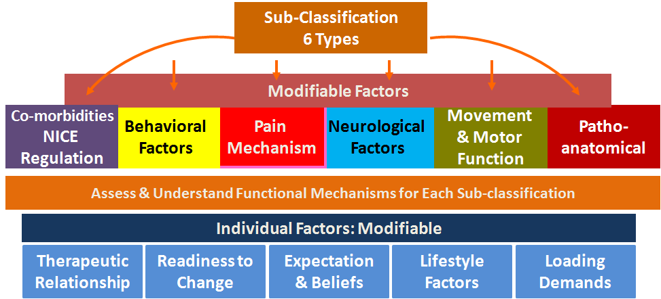

Slide 38
Sub-Group2: Motor Function
Movements Patterns
Translation control
Respiratory control
Motor Fitness

Slide 40
Sub-Group3: Neurological Factors - CNS coordination
Neurocognitive and learning abilities
Sensory motor function
Neurological soft signs
Primary/Postural reflexes integration
Midline and body awareness

Slide 41
Sub-Group3: Neurological Factors - CNS coordination
1. Neurocognitive and learning abilities
Spelling / Counting
Motor Learning
Visual imagery
Memorization
Directions
Recount daily activities

Slide 42
Sub-Group3: Neurological Factors - CNS coordination
2. Sensory motor; specific sensory training
Hearing (vestibular); spatial orientation of sound
Sight; smooth pursuit and tracking exercises
Touch; two point discrimination retraining
Smell; progressive desensitization to specific smells
Taste; progressive desensitization to specific tastes

Slide 43
Sub-Group3: Neurological Factors - CNS coordination
3. Neurological soft signs
Poor coordination
Poor speed and/or accuracy of movements
Poor balance
Dysrhythmias

Slide 44
Sub-Group3: Neurological Factors - CNS coordination
3. Neurological soft signs
Poor coordination
Poor speed and/or accuracy of movements
Poor balance
Dysrhythmias

Slide 45
Sub-Group3: Neurological Factors - CNS coordination
4. Primary/Postural reflexes integration
Non-properly integrated reflexes have an impact on the tone of the involved muscles.
Learning/recovery mechanism for the body
Body can get "stuck in them", altering tone and predisposing to mechanical stress and potential damage
e.g. STNR, ATNR, Babinski, Landau, Moro, Spinal Galant Rolling, Crawling

Slide 46
Sub-Group3: Neurological Factors - CNS coordination
5. Midline and body awareness
If Brain does not have a good understanding of body position in space, can produce increased stress and mechanical tension on a patient’s body
These patients rely on increased tension to have some degree of feedback of a body part.
e.g. Body image drawing based on pain/tightness

Slide 47
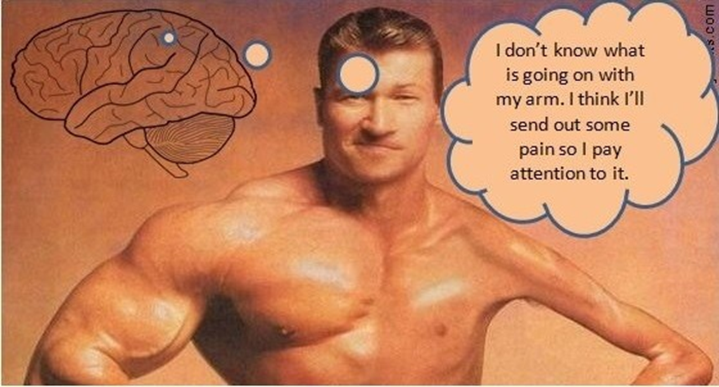
Sub-Group3: Neurological Factors - CNS coordination
5. Midline and body awareness

Slide 48
5. Midline and body awareness

Slide 49
Sub-Group 4:Pain Mechanisms
Nociceptive (depends on tissues involved)
Neuropathic (lesion to the somatosensory system – carpal tunnel/diabetic neuropathy)
Neurogenic (mechanical strain – double crush, myofascial trigger point)
Central sensitization (augmented central response)
Body image pain (Pain as response from impaired body image)

Slide 50
5. Midline and body awareness

Slide 51
Subgroup 5: Behavioral Factors Rehab
PSF= Coping mechanisms, catastrophizing, emotional issues, hopelessness, expectations, beliefs, motivations, frustrations.
Important to recognize and address the presence with patient. We might be able to teach basic coping skills, but mostly we refer out.

Slide 52
5. Midline and body awareness

Slide 53
Subgroup 6: NICE Dysregulation
Systemic Changes to Chronic Low-grade inflammation
N- Neurological
I – Immune
C- Cardio-Metabolic
E- Endocrine

Slide 54
Subgroup 6: Comorbidities –NICE Dysregulation
Systemic Changes to Chronic Low-Grade Inflammation
Lifestyle changes!
Diet
Stress
Sleep
Regular physical activity
Supplements
Smoking/ Alcohol/ Weight Control

Slide 55
Subgroup 6: Diet-Related Systemic Inflammation
Pro inflammatory diet has been associated with longer and more severe pain.
Pro inflammatory diet is partly mediated by genetic factors and predisposition to have an immune response in the gut with specific foods.

Slide 56
Subgroup 6: Diet-Related Systemic Inflammation
Main pro-inflammatory foods are:
Red meat
Dairy products
Gluten
Eggs
Corn
Soy
Peanuts
Sugar

