Slide 1
Capital Outlay
NM Aging and Long Term Services Department
Presented by:
Barbara J. Romero, Bureau Chief
Elizabeth Chavez, Project Coordinator
Adam Saavedra, Financial Coordinator

Slide 2
Today’s Presentation topics
Capital Outlay 101
Executive Order
Special Conditions
Grant Articles
Grantee responsibilities
Grant reporting requirements
Grants Administration

Slide 3
What is Capital Outlay?
Capital Outlay funding is intended for the acquisition, improvement, alteration or reconstruction of assets for long term use. This includes land, buildings, equipment, furnishings, vehicles, code compliance, and ADA compliance improvements. ​
The funds come from 3 different sources: Severance Tax Bond, General Obligation Bond and General Fund revenues. These are all based on the states bonding capacity and the willingness for property owners to have the taxes increased. ​
The state sets aside 20% for Senior Severance Tax projects such as Tribal Infrastructure 5%, Water Trust Board 10% and Colonias Infrastructure 5% projects.
The New Mexico Constitution Article 9, Section 14 prohibits Capital Outlay funds to be used to benefit of a private non governmental entity. (Anti-donation clause). Neither the state nor any county, school district or municipality, except as otherwise provided in this constitution, shall directly or indirectly lend or pledge its credit or make any donation to or in aid of any person, association or public or private corporation or in aid of any private enterprise for the construction of any railroad; provided.
The funds cannot be used for operating expenses such as salaries, supplies, events, brochures, retroactive reimbursements of previous payments, loan payments or legal or administrative fees.

Slide 4
Capital Outlay continued……
Non-construction projects (vehicles, or equipment) are granted for 2 years
Construction projects are for 4 years
It is imperative that the funds be spent within the times set in the grant agreement.
*Capital Outlay grants smaller than $10,000 are not economically feasible when you consider paperwork, personnel time and loan requirements factored into the cost.

Slide 5
State bonds
Severance Tax Bond
General Obligation Bond
Funds are derived from royalties paid by companies that severe a natural resource from the earth such as oil, gas, timber, or mineral products like copper, gypsum, pumice​
Use of the funds are subject to the State Board of Finance Bond Project Disbursement Rule NMSA 2.61.6.1​
*Funded every year depending on the bonding capacity​
General obligation bonds are repaid through property taxes and must be approved through a general election. Capacity is1% of statewide assessed property value from the prior year less the outstanding bond debt
Use of the funds are subject to the State Board of Finance Bond Project Disbursement Rule NMSA 2.61.6.1​
*GOB are used for institutes of higher education, public libraries and senior centers. Funded in even numbered years​
Use of the funds are subject to the State Board of Finance Bond Project Disbursement Rule NMSA 2.61.6.1.
Payments are made in cash or cash equivalents from the pledged revenue source over a period of 7 to 10 years (useful life). ​
​

Slide 6
General Fund
The vast majority of general fund revenue comes from taxes. The state collects different taxes from different sources.
taxes we pay on the goods and services we purchase.
personal income and the profits of corporations.
public resources, such as crude oil and natural gas that are extracted from our land.
fees for things like driver’s licenses
A very small amount of revenue comes from gaming compacts with tribal casinos
The State of New Mexico’s operating budget
The budget that determines recurring spending, such as operating programs and services like public school education, and some nonrecurring spending.
Operations money comes from the state general fund and from federal funds.
*State does not normally use to fund Capital Outlay except in session 2019

Slide 7
Bond Questionnaire - Spend-down Rule NMAC Title 2
Approximately 45 days prior to the bond sale, the NM State Board of Finance (SBOF) will notify the recipient that a bond questionnaire needs to be completed using – Capital Projects Monitoring System (CPMS) database http://cpms.dfa.state.nm.us
5% - will you have the ability to enter into 1 or more contracts with vendors to expend funds within 6 months of sale - for 2020 projects – November 12, 2021
85%- will you have the ability to expend within 18 months from sale – for 2020 projects May 12, 2024
If you are not able to agree to above terms then you should not certify the bonds as ready to sell and wait until next bond sale

Slide 8
How do we ask for
Capital Outlay funds?
Using the ALTSD application database – open in February for 60 days. – login and passwords are required. – Service providers need permission from the local or tribal governments for access.
The application categories are; A-1 code compliance, A-2 renovation, A-3 meal or other equipment, A-4 vehicles, A-5 new construction, and A-6 plan and design.
The Project Review Team reviews the applications submitted and gives a score for projects within each category.
ALTSD will provide a list of recommended projects for funding to the executive for consideration
ALTSD will present the recommendation to the Capital Outlay and Legislative Finance Committee prior to the start of the Legislative session.
Review your asset management plans

Slide 9
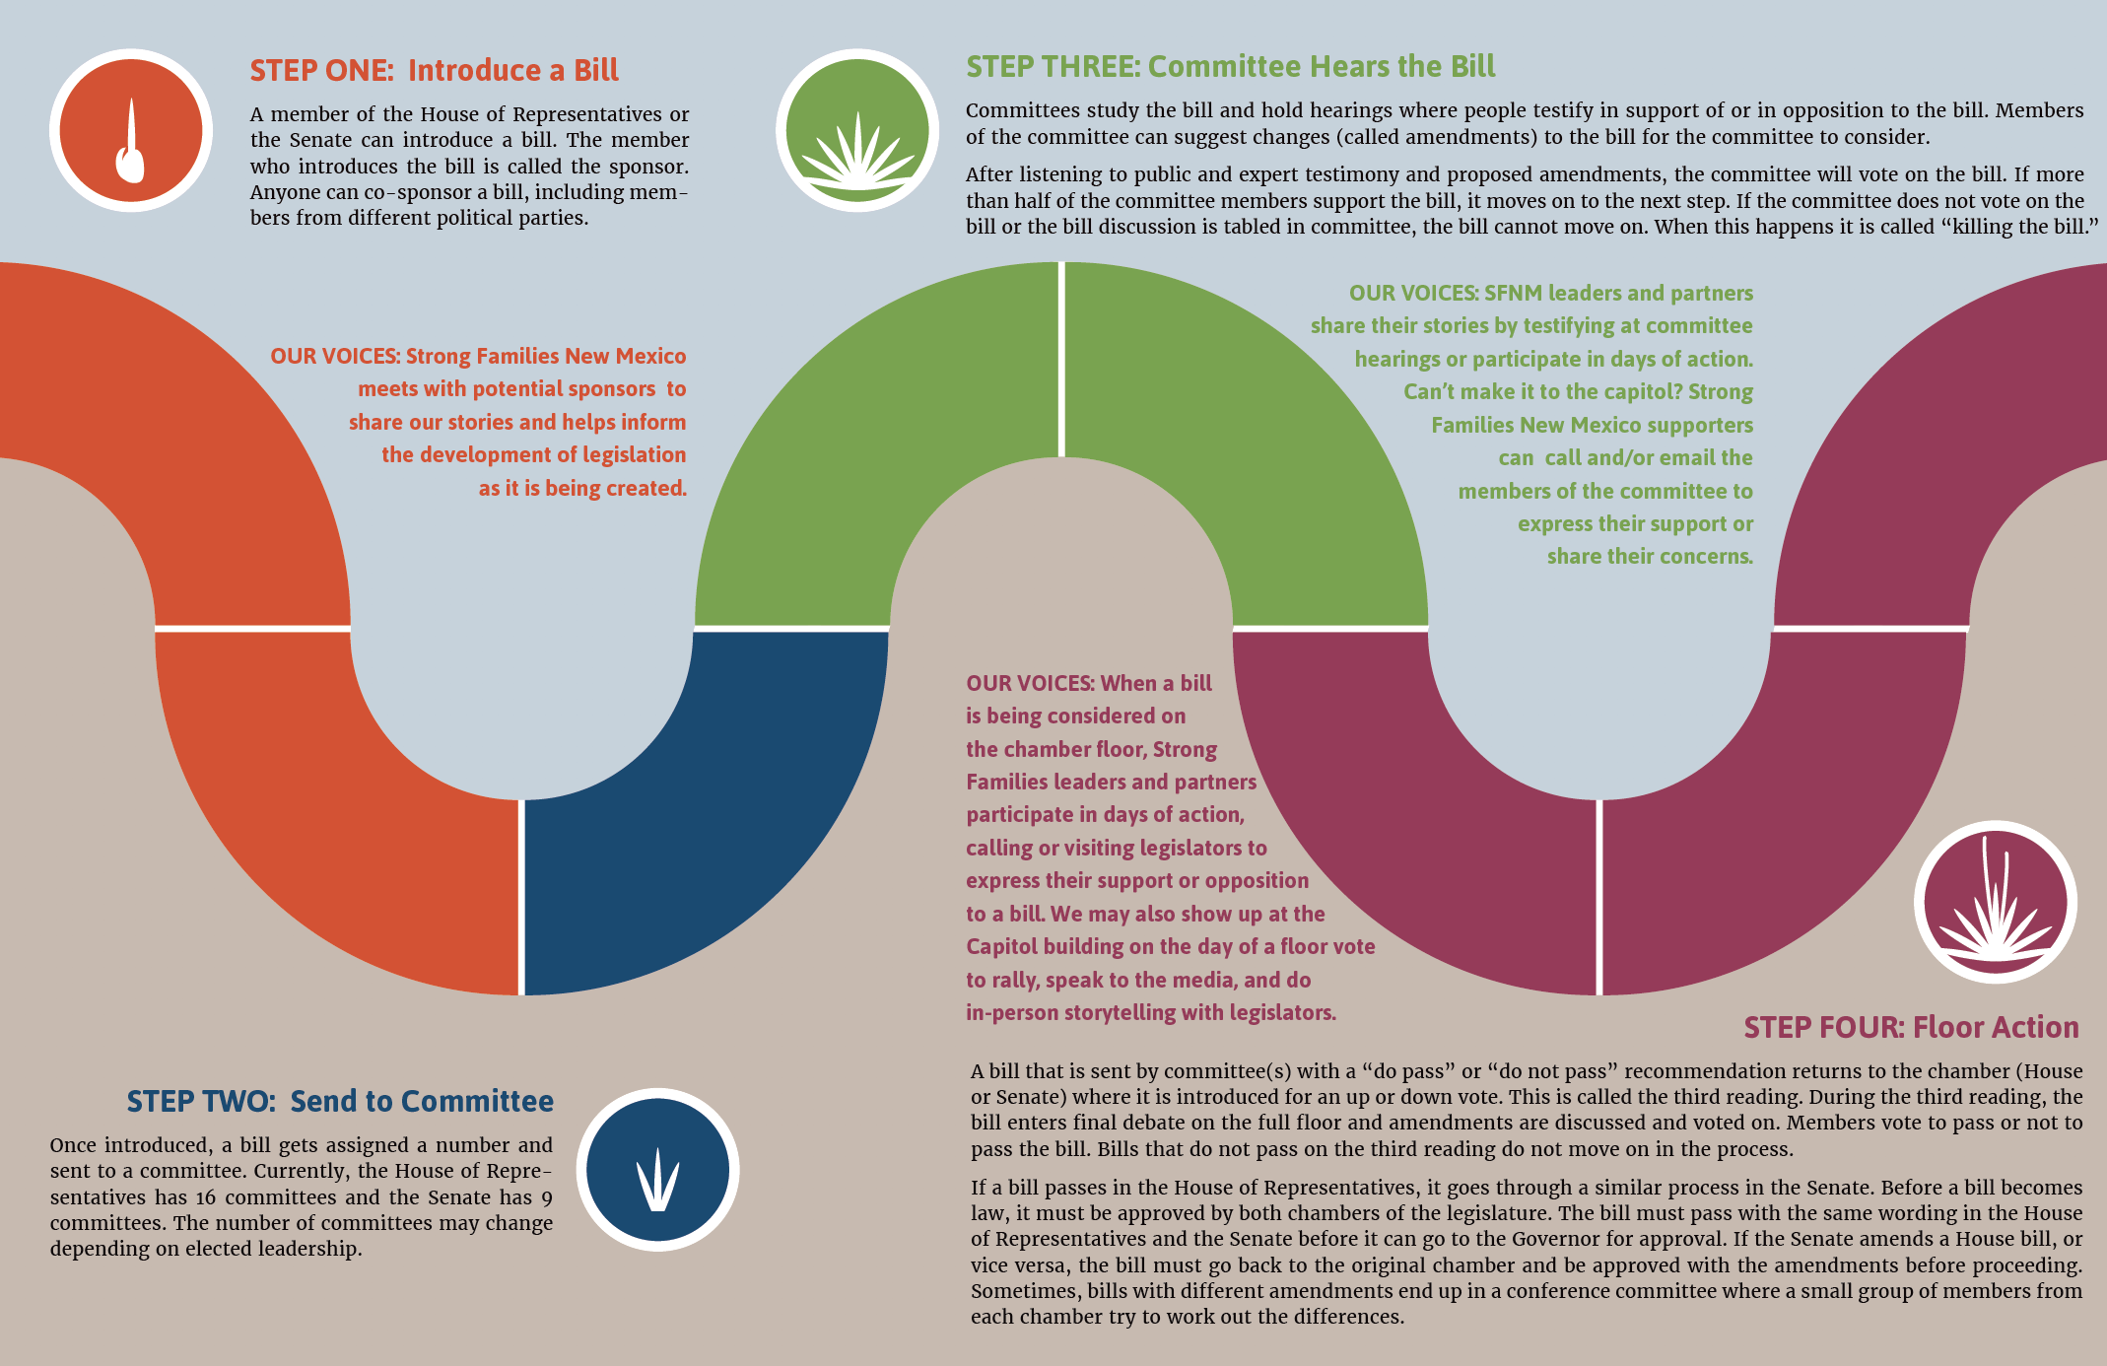
Bill passage process
forwardtogether.org

Slide 10
Effective dates of law
Session Dates​
January 4, 2021 - January 15 Legislation may be pre-filed​
January 19, 2021 - Opening day (noon)​
February 18, 2021 - Deadline for introduction​
March 20, 2021 - Session ends (noon)​
April 9, 2021 - Legislation not acted upon by governor is pocket vetoed​
June 18, 2021- Effective date of legislation not a general appropriation bill or a​ bill carrying an emergency clause or other specified date

Slide 11
If Awarded? When do we get the $$
First the bonds must be sold and DFA prepares the capital outlay budgets
The Department will issue an award letter indicating the type of project and the amount received and request a scope of work outlining timeframes, costs and milestones. The award letter will also note if there is a special grant condition imposed on the release of the grant
The grantee or the fiscal agent must be in compliance with Executive Order 2013-006
Capital Outlay funds are on a reimbursement basis. (you must expend the funds first and then submit a request to ALTSD including invoices, cancelled checks and copies of contracts on the approved request form)

Slide 12
Executive Order 2013-006
On May 2, 2013, the Governor signed the EO establishing uniform funding criteria and grant management and oversight requirements for grants of State capital outlay appropriations by State agencies to other entities and requires the following compliance;
Ensure that grantee has sound fiscal practices.
Ensure grantee submits audits, budgets and financial reports timely
Agency review of audit to determine deficiencies that would limit the ability to administer the grant
Avoid Unconstitutional outcomes – Anti donation violation issues
Protect public funds
Projects are certified as eligible prior to bond sale
Uniform grant management practices

Slide 13
Executive Order 2013-06
Agency Responsibilities
Review audit for deficiencies identified in the opinion letter, financial statements, management discussion and analysis, and supplemental information, internal control, schedule of findings and questioned costs, summary of prior year findings and implement special conditions as part of the grant agreement
Determine if the grantee has the resources to implement grant agreement if not then a suitable fiscal agent
Complete and submit a Uniform Funding Criteria form for each grantee to DFA
Monitor grantees compliance with uniform funding criteria and mitigate non-compliance
Receive approval of deviations from any of the policies and procedures from DFA Cabinet Secretary prior to implementation
Monitor the private use of state capital assets – (anti-donation clause) License to use agreement
Use the new revised grant agreement template

Slide 14
Special Grant Conditions
The capital outlay oversight requires grantees’ accounting methods and procedures, including their internal control framework, to be scrutinized, so as to safeguard State capital outlay appropriations and assets acquired with such appropriations.
Procurement
Budgets
Capital Assets
Travel & Per Diem
Timely Audits
Cash Management

Slide 15
Conditions…..
Procurement – The Grantee shall submit the following to ALTSD in pursuit of prior approval: purchasing policies and procedures, copies of bid documents, documentation of management and program approval, policies and procedures governing purchasing and contracting, a copy of the current procurement and contracting policies, and documentation regarding informing staff responsible for purchasing and contracting on such policies and procedures
Budgets – Provide documentation of approval of your current budget from DFA Local Government or other authoritative agency. Provide policies and procedures on who is responsible for and how annual budgets (expenditures and revenue) are established, monitored and adjusted. Provide a corrective action plan on how budget issues identified in your audit will be/have been addressed. Also include documentation on how staff responsible for budgeting is informed on budget policies and procedures.
Capital Assets – Provide a complete list of inventory including inventory control numbers and current location. Provide policies and procedures on capital assets and inventory and specify how the proposed purchased items will be included, tagged, and tracked in capital asset inventory. Also include documentation on how staff responsible for capital assets is informed on capital asset policies and procedures.

Slide 16
Conditions
Travel & Per Diem - Provide policies and procedures on travel and per diem. Also include how staff who travel and those responsible for travel reimbursement are informed on travel and per diem policies and procedures.
Timely Audits - Provide policies and procedures on annual audits. Provide documentation on how and who is responsible for insuring that annual audits are completed timely. Also include documentation on how staff responsible for the annual audit is informed on audit policies and procedures.
Cash Management – Provide policies and procedures on cash management of federal funds. Provide procedures used to draw and disburse federal funds. Provide procedures to reconcile draw amounts, deposits and disbursements; and to prepare federal cash reporting documents to ensure compliance with federal regulations.

Slide 17
Grant Agreement Articles
Article I - PROJECT DESCRIPTION, AMOUNT OF GRANT AND REVERSION DATE – This article describes the intent of the law or allowable uses of the funds, the appropriation amount and the expiration date.
Article II –LIMITATION ON DEPARTMENT’S OBLIGATION TO MAKE GRANT DISBURSEMENT TO GRANTEE – This article discusses the department’s ability to make payment and the requirements to submit a Notice of Obligation once a contract has been issued or purchase requisition is established.
Article III - NOTICE PROVISIONS AND GRANTEE AND DEPARTMENT DESIGNATED REPRESENTATIVES – Contact information for grantee and department.
Article IV – REVERSION DATE, TERM, EARLY TERMINATION – This article identifies the reversion and the requirement to expend funds on or before that date regardless of a third party contract
Article V – EARLY TERMINATION – This article discusses that the department can terminate the agreement once the project is completed, funds were expended in full, violation of terms, mishandling of public funds
Article VI – SUSPENSION OF NEW OR FURTHER OBLIGATIONS - This article discusses the departments ability to direct the grantee to cease entering into an obligation.

Slide 18
Grant Agreement Articles cont….
Article VII – AMENDMENT – both parties must execute any changes to the grant agreement if deemed appropriate by agency.
Article VIII – REPORTS – discusses the paper reporting, paperless reporting and the final report and requests for additional information and retention period.
Article IX – REQUEST FOR PAYMENT PROCEDURES AND DEADLINES – process for requesting reimbursement, supporting documentation and deadlines.
Article X – PROJECT CONDITIONS AND RESTRICTIONS; REPRESENTATIONS AND WARRANTIES – funds must be spent in accordance with state laws, implemented in accordance with NM Public Works Act, must not be in violation of the “Anti-Donation Clause”, project cannot be converted to another use, EEO, Grantee has the ability to receive and expend funds, authorized signatory, agreement does not conflict with grantees obligations, grantee has reviewed and agrees with project description, amount and expiration date and is consistent with the appropriating law, grantee shall abide with all state laws including; conflict of interest, governmental conduct, whistleblower act, language to be included in all contracts and subcontracts regarding lobbying.
Article XI - STRICT ACCOUNTABILITY OF RECEIPTS AND DISBURSEMENTS; PROJECT RECORDS – Maintain files for 6 years after the project has been completed
Article XII - IMPROPERLY REIMBURSED FUNDS – department has the ability to request funds paid to the grantee under fraud, mismanagement, misrepresentation, misuse, or violation of law.

Slide 19
Grant Agreement Articles cont….
Article XIII – LIABILITY – NM Tort Claims Act (other party’s acts or omissions)
Article XIV – SCOPE OF AGREEMENT – What is written in the agreement shall be what governs the use regardless of any other conversations between grantee and department
Article XV – REQUIRED NON-APPROPRIATIONS CLAUSE IN CONTRACTS FUNDED IN WHOLE OR PART BY FUNDS MADE AVAILABLE UNDER THIS AGREEMENT – contingent upon the legislature to authorize and appropriate
Article XVI – REQUIRED TERMINATION CLAUSE IN CONTRACTS FUNDED IN WHOLE OR PART BY FUNDS MADE AVAILABLE UNDER THIS AGREEMENT - termination clause in all contracts in case department cancels the grant you have the ability to cancel the contract and pay out the liability for goods and or services received up to that point.
Article XVII – COMPLIANCE WITH UNIFORM FUNDING CRITERIA - EO 2013-006
Article XVIII – SEVERANCE TAX BOND AND GENERAL OBLIGATION BOND PROJECT CLAUSES - subject to the State Board of Finance rules and regulations including the Bond Project Disbursement Rule http://www.nmdfa.state.nm.us/uploads/FileLinks/e9943484096d40d49e26f46f50a93748/2_61_6_NEW_disbursement_rule.pdf

Slide 20
Grants Management

Slide 21
ALTSD WEbsite
Please visit our website for information regarding our department capital outlay process, deadlines, application dates, past presentations, and grant forms http://www.nmaging.state.nm.us/capital-outlay.aspx
It is imperative that you fully understand the previously mentioned Articles in the agreement to effectively manage your grants.
  Timelines
  Notice of Obligation
  Scope of Work
  Reporting Requirements
  Expenditures
  Reimbursement
  Close out Procedures
20 points are assessed during the application review process for reporting, spenddown and oversight.

Slide 22
Timelines
To the extent possible please adhere to timelines set by staff in the correspondence sent to you
Questionnaires – usually it is a short response period – 1 week (completed online) – NM State Board of Finance will contact you for more information
Request for additional information – (by phone or e-mail) if we did not indicate a return date then assume we need it immediately
Memo sent from our office will include a respond by date or submit by date
Scope of work will include a return date
Special condition documentation – release of grant is dependent on approval.

Slide 23
Notice of Obligation
Article II of the grant agreement – (before you spend)
  Submit completed third party obligation to ALTSD along with; (cost estimate, quote, contract, and or purchase requisition)
  Notice of obligation will be effective on the date issued by ALTSD.
  Department can request additional documents to justify the obligation
  Notice of Obligation will only be issued for work or equipment identified on the approved Scope of Work
  Notice of obligations will not be issued if ALTSD does not feel the expenditure will occur before reversion date

Slide 26
Scope of Work
Use the template created by ALTSD, posted on our website
Customize for the tasks that you will be completing
Make the timelines realistic – take into account the grant contracting period, order, delivery, installation, internal processing timelines
Request a sample of approved scopes for similar projects
Include the disposition method to be followed

Slide 27
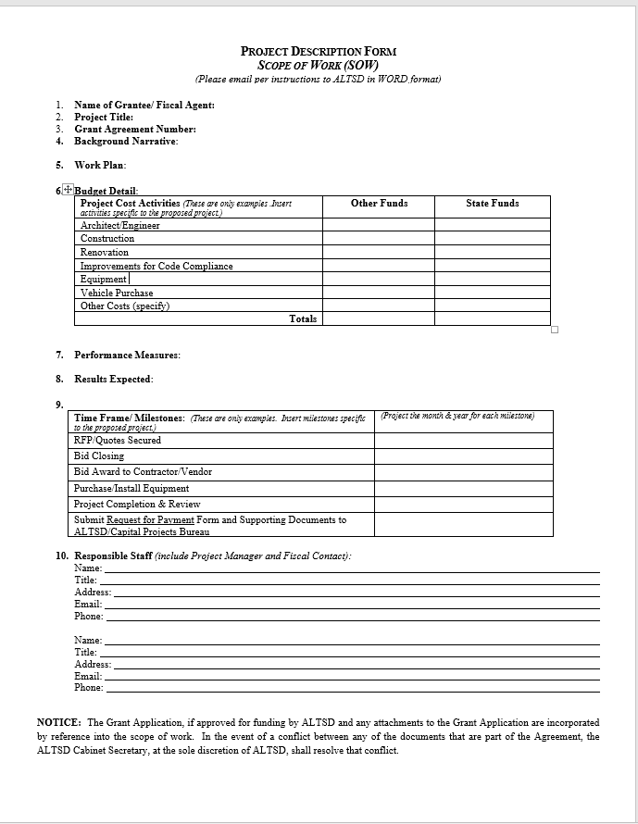

Slide 28
Reporting
Paper reports are no longer required.
Online reports are due the 30th of the month in the Capital Projects Monitoring System (CPMS) http://cpms.dfa.state.nm.us/
Additional request for information will be requested in writing
Reports must be informative and explain in detail the status of the project. No activity????!!!! Refrain from using acronyms.
ALTSD will not process the reimbursement until the report is submitted in CPMS
Reporting periods prior and during the Legislative session are the most important. (December, February, and March)
There may be a timing issue information between the grantee and the department. Grantee reports monthly and Agency reports quarterly.

Slide 29
Expenditures
Ensure that expenditures are only for the intended purpose and approved scope of work.
Contact ALTSD if you have questions if an item to be purchased or constructed is an allowable expense.
Expenditures must be made and item received on or before the reversion date to qualify for reimbursement
ALTSD will provide written denial for items that are not allowed.

Slide 30
Reimbursement Requests
Reimbursement for expenditures must be requested 20 days from the end of the quarter
SBOF limits requests to $1500 or more unless this is the end of the fiscal year or it is the final reimbursement request
End of fiscal year deadlines are early July to allow time for corrections and internal processing
Exhibit 1 must be typed and computation must be correct – include AIPP if applicable (Article I) – See Exhibit 1 instruction document
Copy of invoice, purchase orders, cancelled checks, notice of obligation and title and odometer disclosure for vehicles must be included
FY21 (July 1, 2020 - June 30, 2021)
FY22 (July 1, 2021 - June 30, 2022)

Slide 31
SUPPORTING DOCUMENTS
Equipment | Construct/Reno/Code | Vehicles
Exhibit 1 form | Exhibit 1 form | Exhibit 1 form
Copy of Invoice | Copy of Invoice | Copy of Invoice
Copy of cancelled check or EFT​ | Copy of cancelled check or EFT​ | Copy of cancelled check or EFT​
​Copy of Notice of Obligation | ​Copy of Notice of Obligation | Copy of Notice of Obligation
​ | ​ | Copy of Buyer’s Agreement​
 |  | Copy of Certificate of Origin or Title​
 |  | Copy of Odometer Disclosure Statement​

Slide 32
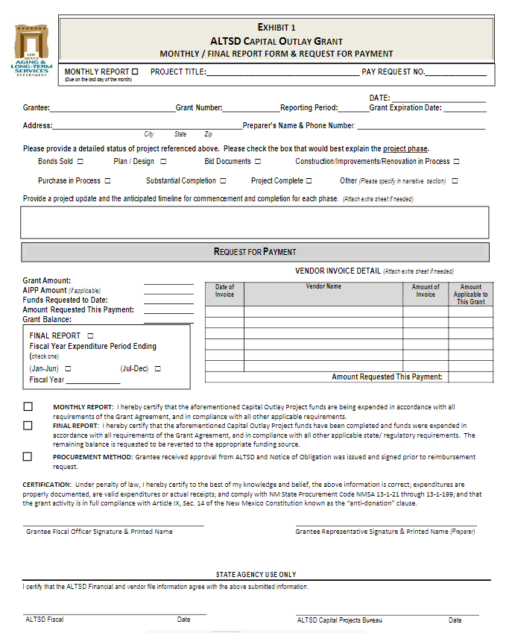

Slide 34
Close out Procedures
Ensure that all expenditures have been reimbursed prior to submission to request close out
Upon submission of final pay request send an additional letter requesting that the project be closed
ALTSD will mail a close out letter detailing the expenditures and any reversions
Make sure that you enter the completion dates in CPMS

Slide 35

Questions????
Barbara J. Romero – barbara.romero@state.nm.us - 505-365-3660
Elizabeth Chavez – elizabeth.chavez@state.nm.us - 505-365-3804
Ernest "Adam" Saavedra – ernest.saavedra@state.nm.us - 505-490-3367

